Slide 1
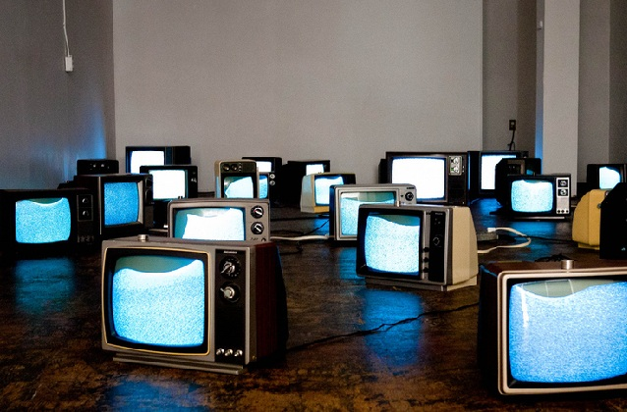
HISTORY OF THE TELEVISION

Slide 2
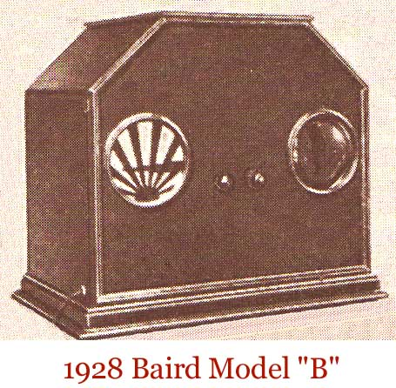
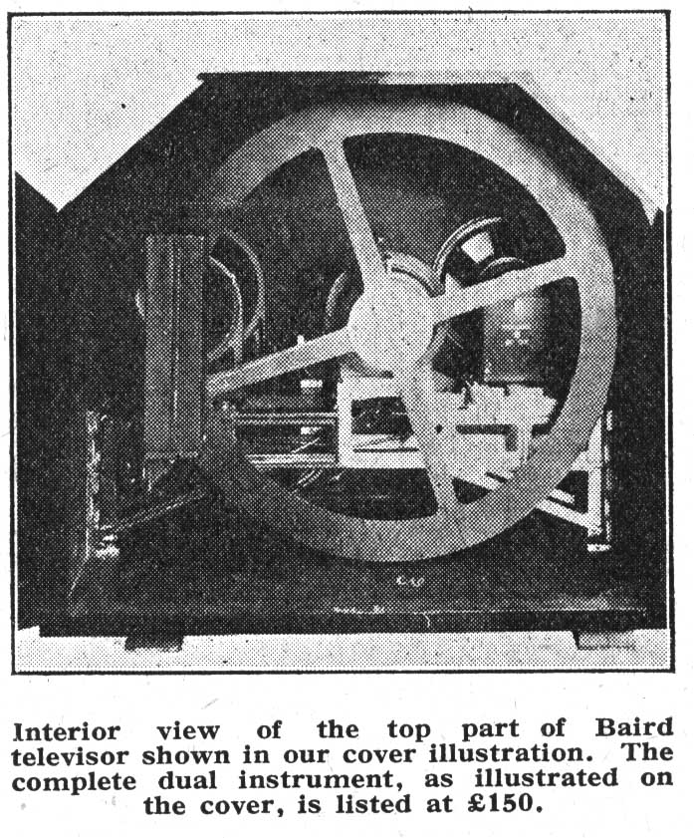
The Baird Model B is a very early television which is considered to be the first commercial TV. One problem was it had a very small display so only one person could look through it. This was a new product that sold very few copies and was mostly a technical preview. The box was made of wood and was finished professionally like a real commercial product. Finally they were fairly reliable out of the 20 made there is still 1 left working, after nearly a century.
Baird Model B, 1928(SKETCH)
(One of the first commercial Mechanical TV sets)

Slide 3
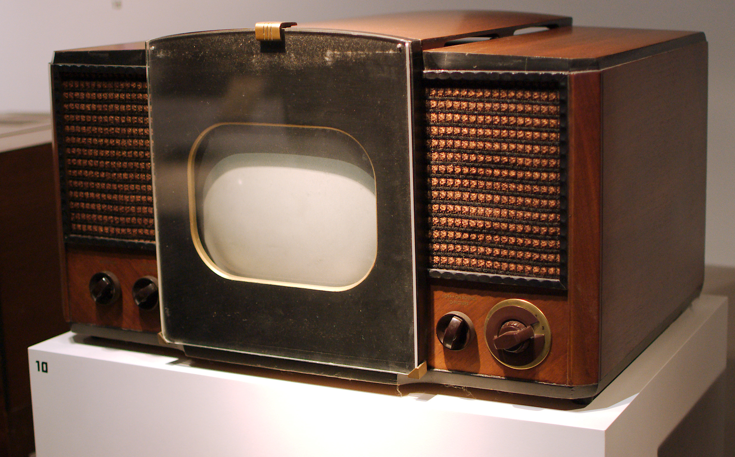
The RCA is the first mass produced TV set and was a lot more popular than the Baird Model B. It featured a “GIANT” for the time 10 inch B&W screen. One problem though is the weight at around 85 pounds without the stand. It is very different from the Baird due to it being electric rather than mechanical. It also has a similar wooden finish to the Baird making it look nice however it was expensive and had large bezels. Finally the TV needs to be plugged in and in the 40s some houses would catch on fire if the wiring was faulty.
The RCA 630-TS, 1946
(First Mass Produced Electric Commercial TV set)

Slide 4
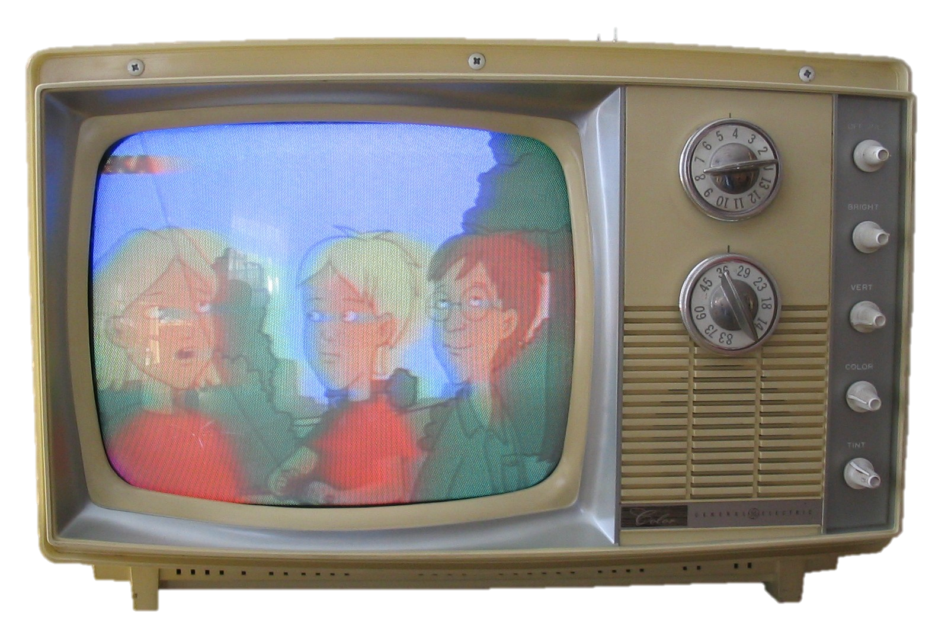
This TV mainly features a portable design. It is meant to be moved around and had a very compact form for its time at around 24 lbs. It featured a plastic design that was unprofessional but helped make the product cheap and portable. This was an impressive device due to it processing color video early on in the color tv era. It was shown to be a more reliable color model and a better consumer device than previous devices. Finally the bezels were a lot thinner than previous devices.
The GE Porta Color(First “Portable” Commercial TV) (1966)

Slide 5
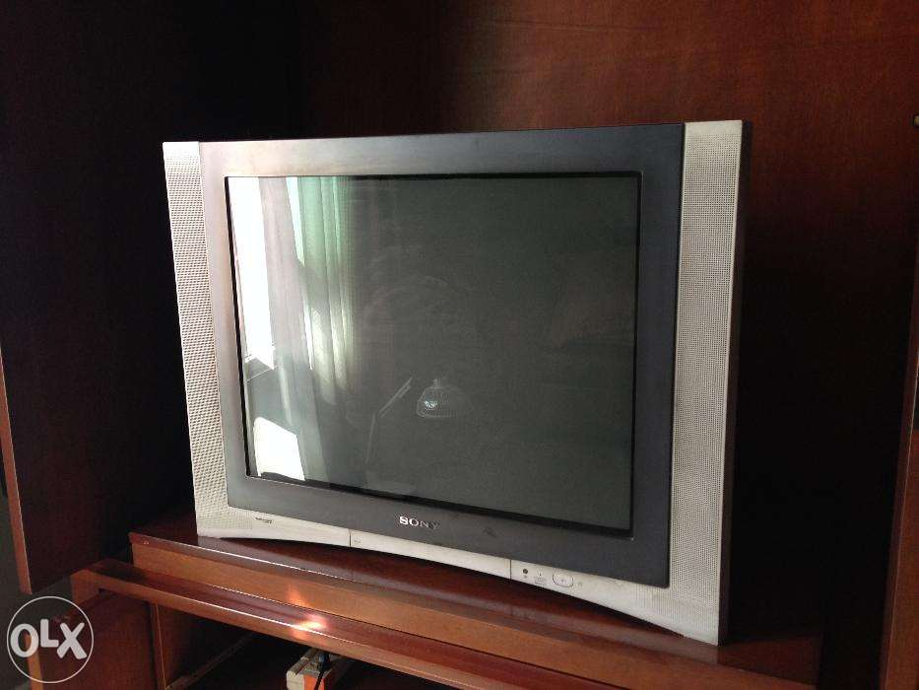
Flat Screen TV provided a thin and small bezel TV. This provided a better appearance to TV and this also provided a better picture and better immersion. One problem though is since that the TV is thin so if some pressure is applied the TV could flip over and break. Often these TVs would also use reflective plastic to create an impression of metal. Finally it has an incredible quality and resolution.
FD Trintion(Photo) 1998
First Flat Screen TV

Slide 6
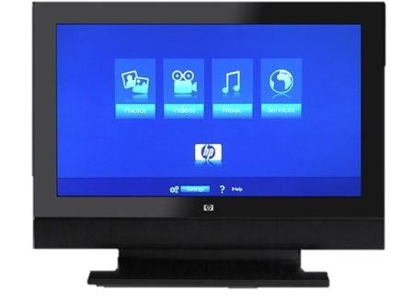
Smart TV’s are the next generation of TV, with the Invention of the Internet these Televisions provide TV shows, Movies and Video Games in one experience. It had the similar problems with the Flat screen with a similar design but they improved on this model. It had thinner bezels and it even is wireless so it improves safety it also is less reliable though since depending on the Wi-Fi connection speed the device can succeed or fail. Another thing is as technology improves people want stuff to get bigger so TVs are getting bigger and bigger so TVs are getting Gigantic. Finally advertising shows all these applications on their TV but to get any of these like Netflix or WWE you have to pay lots of money more.
HP Mediasmart TV (SL3760)(2007)
(Artist Representation)
First Smart TV

Slide 7
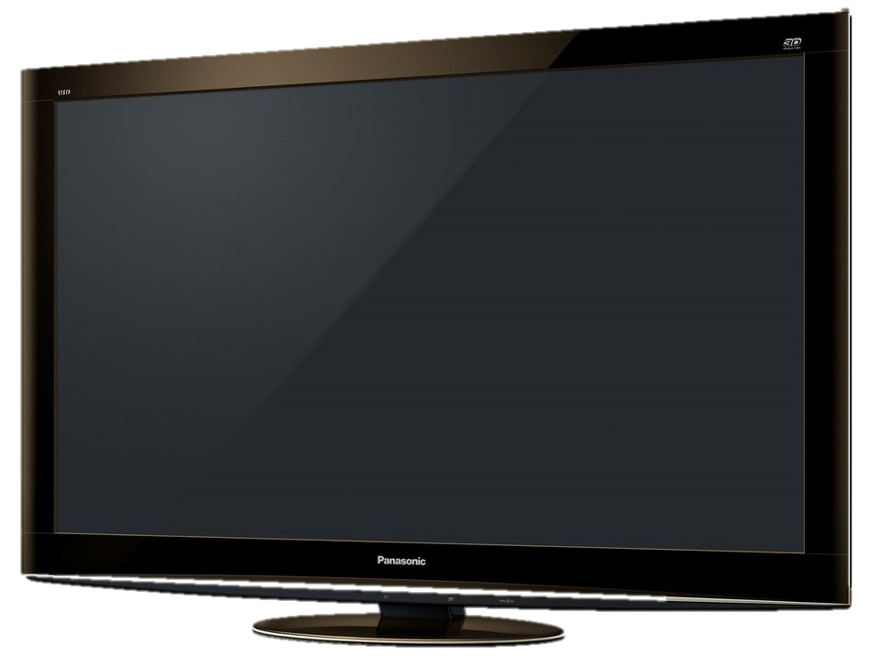
3D TV is a new product that has changed TV. It provides larger bezels however it provides a lot more features. They are a lot larger than the first smart TVs and also is not very safe due to its thin design. Another thing is that these TVs require 3D glasses and they make a lot of people nauseous. They are also not very reliable since the glasses frequently break and are of a low build quality. Finally the material is plastic and is yet again made to look very high quality.
Panasonic Viera VT20 plasma 3D HDTV
(First Full 3d TV)
(3D Model)
(2010)

Slide 8

Evolution of the Computer (Personal)

Slide 9
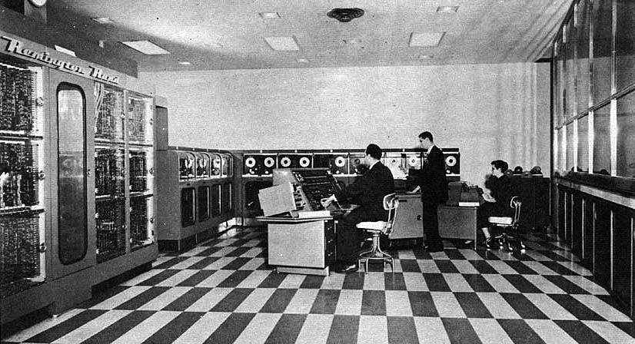
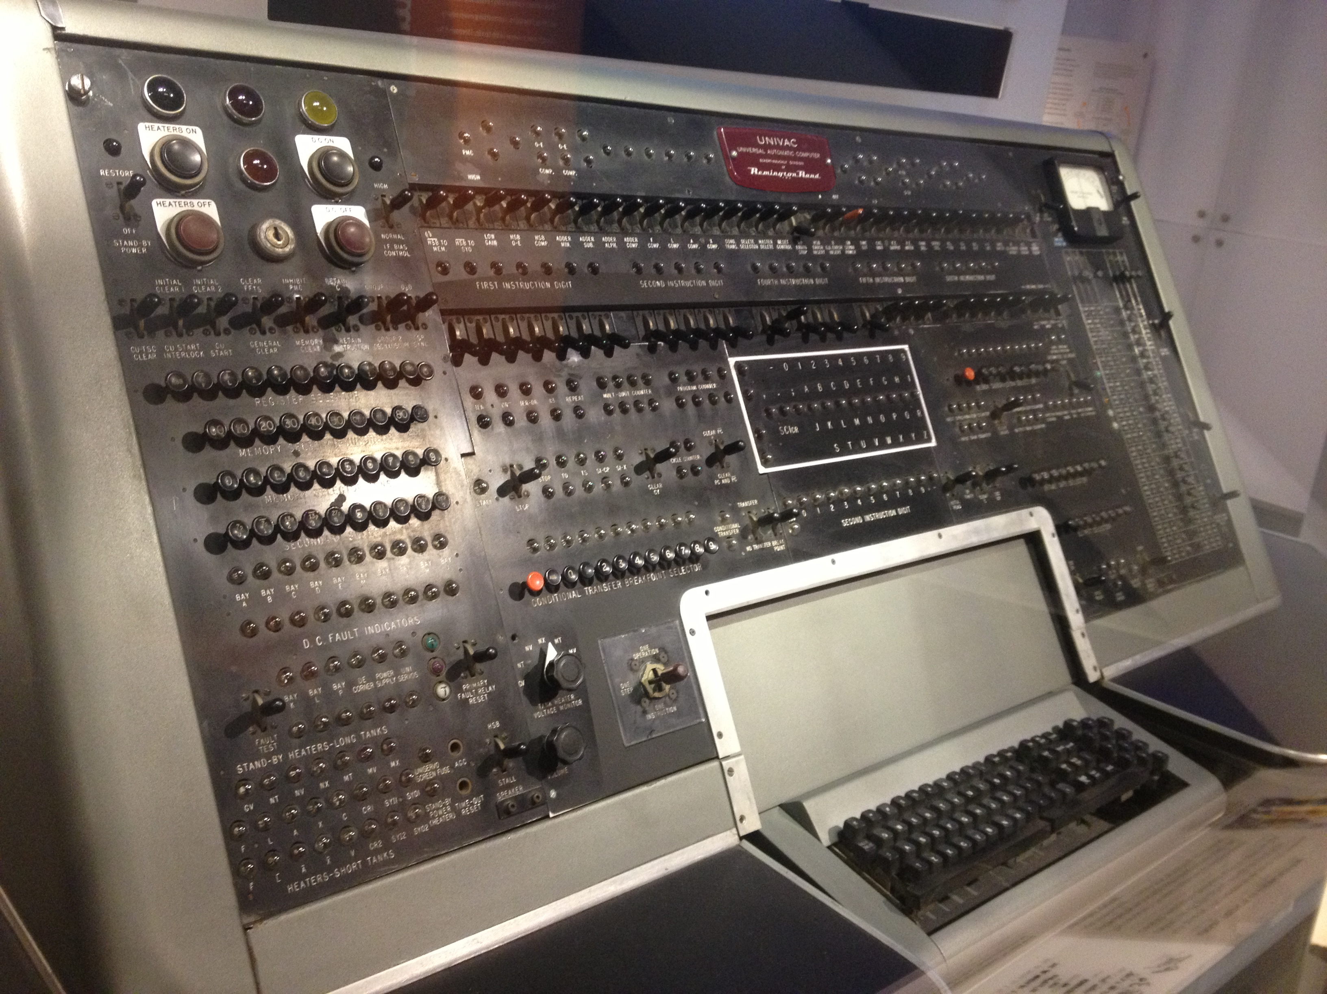
This was the first Commercial computer as you can see it was gigantic as well as ugly. Classroom sized it was also very slow and could barely handle basic arithmetic operations however it did predict that Eisenhower would win the election which was a feat in it self. The computer required 125 kw which is enough to kill any human so everyone who used the machine had to be qualified. It was very expensive at the time reaching about 1.5 million dollars or 14 million dollars today. Finally this device was fairly reliable there are no cases of them failing and some installations were used for 10+ years and retired for new hardware instead.
UNIVAC-1 (First Commercial Computer in the US)(1951)

Slide 10
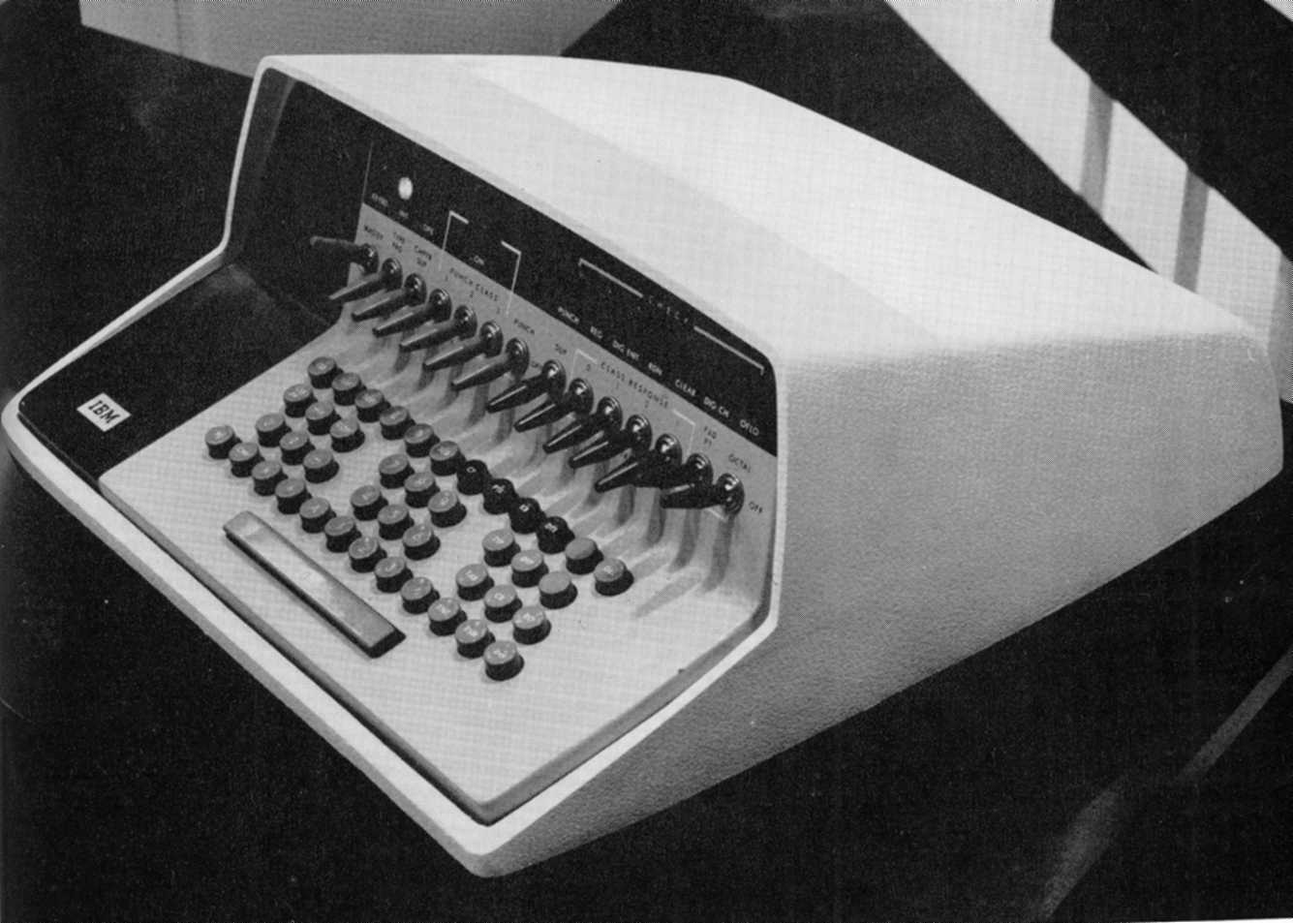
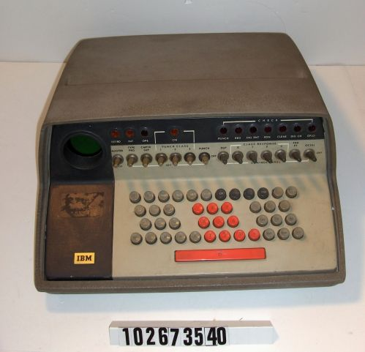
This computer was incredible at its time mainly for its miniature design. It featured a small circular screen at the left hand side which was a poor design choice however it was used to keep the computer small. It was very slow though and was swiftly retired for more updated hardware on 1959. Another problem is that it is made of a cheap plastic that if finished to look professional for an office however that is not the case. Finally it is one of the first computers to be fully controlled by a keyboard past computers had keyboards but were not fully controlled by them.
IBM 610(First Marketed “Personal” Computer)(1957)

Slide 11
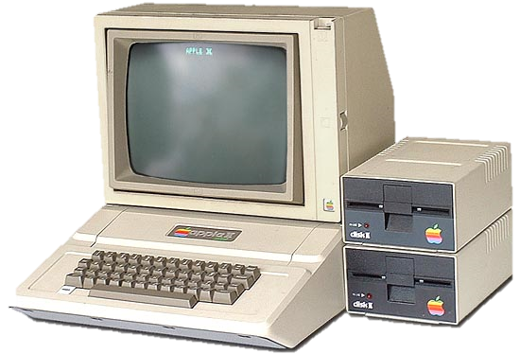
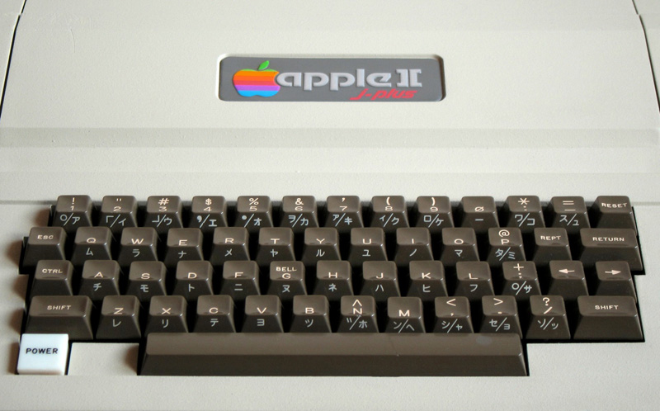
The Apple 2 is one of the first main stream pcs it featured a large monitor compared to the 610 and floppy disk drives to run external programs easier. The appearance is an ugly beige plastic though and has a very bulky appearance. This PC was an amazing step for computers and a lot of programs were made for this computer from word processing to video games. The A pple 2 also used the now standardized QWERTY keyboard layout which is important so that new users do not have to learn a new keyboard layout after every computer they buy. Finally the Apple 2 was upgraded in 1979 and was discontinued in 1981 with a fairly short lifecycle.
Apple II(1977)
One of the first main stream PCs

Slide 12
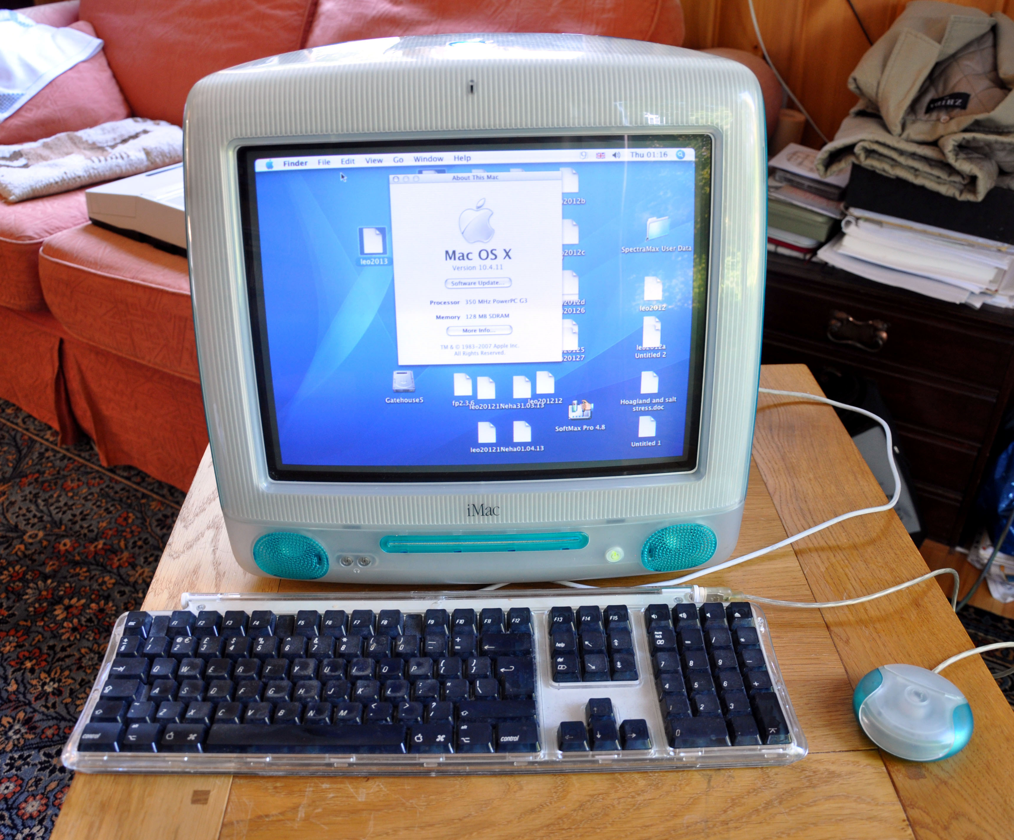
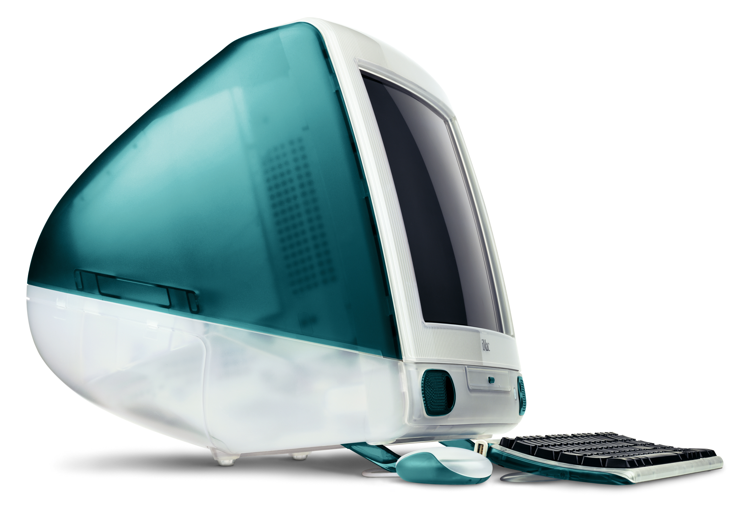
The iMac G3 used a new design where the entire PC fit into the display case. It allows portability and it also features a lot of peripherals add-ons that would change the future of computing like adding external mice and new keyboards. However the blue translucent color choice and design was a very poor choice. Another problem is that the iMac abandoned the floppy disk drive which was a very popular storage standard for USB which was still a new emerging technology. The computer was also fairly slow for the time and was non upgradeable. Finally the product was abandoned quickly only after 5 years like the apple 2’s 4 years.
iMac G3(1998)
(New design for PCs)

Slide 13
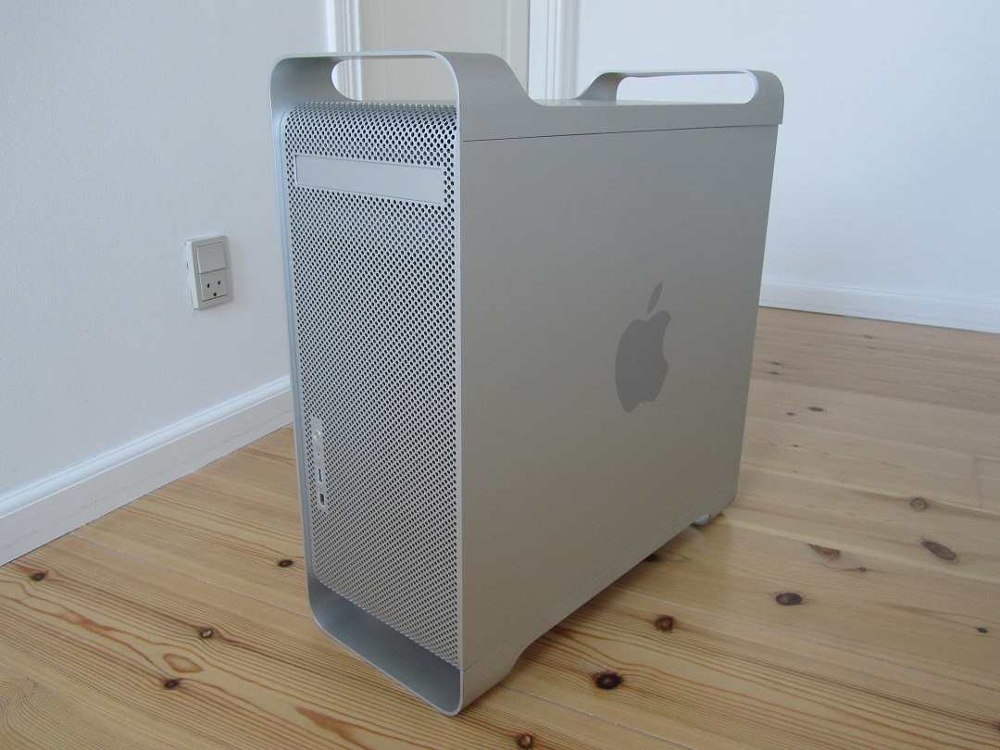
The PowerMac G5 is considered the first 64 bit personal computer allowing the computer to have more than 4 gigabytes of RAM. The box has an amazing appearance made of anodized aluminium with a handle to carry the machine. The PowerMac like all the Apple products only lasted for 3 years. The PowerMac also used a new design known as a tower where the display is beside a big “tower”. There were a lot of defects at launch where heat sinks would leak and damage the internals and corrode the aluminium. Finally the machine would cause a loud annoying chirping noise that would prevent people from working or trying to do anything with audio
PowerMac G5(2003)

